Slide 1
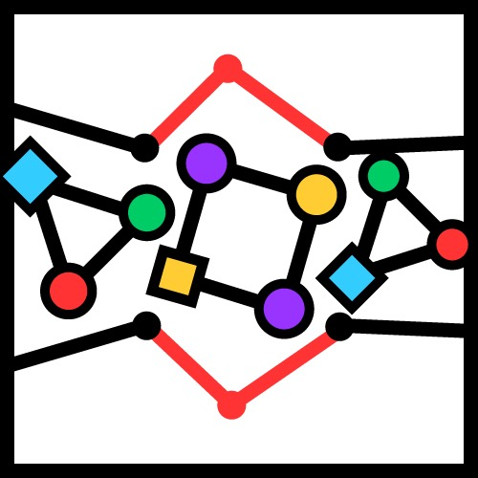
Graph-Based Anomaly Detection: Problems, Algorithms and Applications
Leman Akoglu

Slide 2
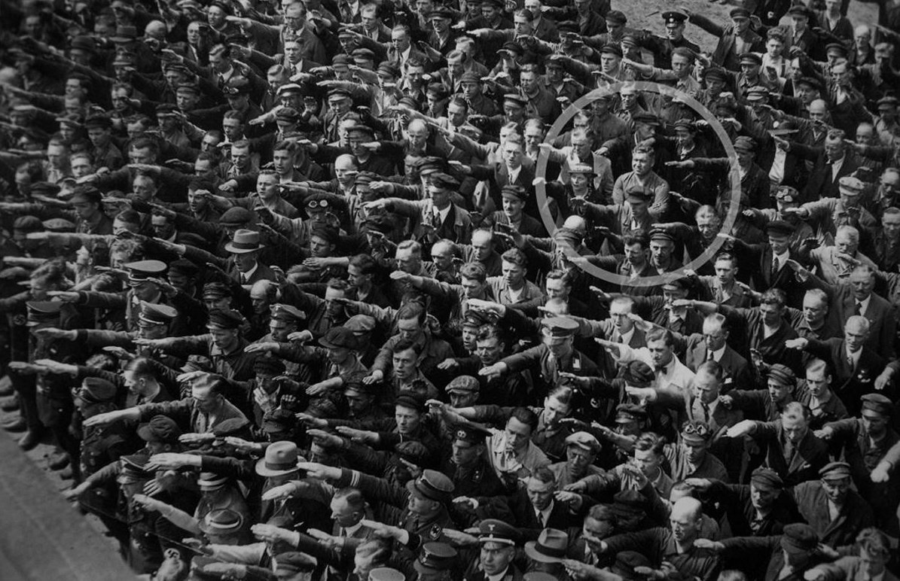
Anomaly: That stands out
https://en.wikipedia.org/wiki/August_Landmesser
2
Notes:
Anomalies are those instances that deviate significantly from the rest of the sample population. In many scenarios, including in this picture, anomalies signal faults in a system.

Slide 3



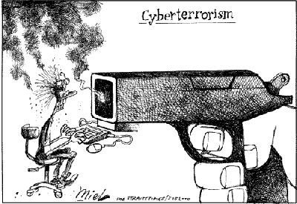







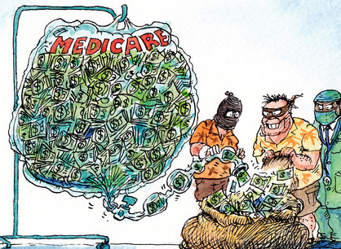



Anomaly Detection: Many Use-cases

Slide 4

Formalizing Anomaly Detection
Concrete problem settings exist. e.g./esp. for point-cloud data
Real-world… A bit more complex.
Collective outliers
Local outlier
Global outlier
4
Notes:
Many formalisms already exist. (Point cloud: Global, Local, Collective) → General-purpose methods
Real-world is a bit more messy, b/c data is not always → Specialized methods
“We heard that you work on anomaly detection”.
→ Yes, I am very excited. Tell me more.
“We have lots of data, and we want to find anomalies in it.”
→ Wait, wait, tell me what your REAL PROBLEMS are. Why you want to detect anomalies? What do you consider an anomaly?
So as simple as : Given <DATA>, find <ANOMALIES> BUT TOO INFORMAL
e.g. : Accounting : Given millions of transactions, find abnormalities
“We want to find errors, inefficiencies, and malfeasance, we want to save $$$ and we want you to find those.”
OK…
“BTW we don’t want too many false positives. Also, data comes in as a stream. ….”
Given <DATA>, find <ANOMALIES> subject to <CONSTRAINTS>
OK OK what <DATA> do you have ?

Slide 5
Formalizing Anomaly Detection
Given <DATA>, Find <ANOMALIES> e.g. (accounting) Given millions of transactions, find abnormalities
We heard you work on anomaly detection.
Yes, I am very excited. Tell me more.
We have lots of data, and want to find anomalies.
OK, wait, tell me what your REAL PROBLEMS are. Why do you want to detect anomalies? What do you consider to be an anomaly?
5
Notes:
Many formalisms already exist. (Point cloud: Global, Local, Collective) → General-purpose methods
Real-world is a bit more messy, b/c data is not always → Specialized methods
“We heard that you work on anomaly detection”.
→ Yes, I am very excited. Tell me more.
“We have lots of data, and we want to find anomalies in it.”
→ Wait, wait, tell me what your REAL PROBLEMS are. Why you want to detect anomalies? What do you consider an anomaly?
So as simple as : Given <DATA>, find <ANOMALIES> BUT TOO INFORMAL
e.g. : Accounting : Given millions of transactions, find abnormalities
“We want to find errors, inefficiencies, and malfeasance, we want to save $$$ and we want you to find those.”
OK…
“BTW we don’t want too many false positives. Also, data comes in as a stream. ….”
Given <DATA>, find <ANOMALIES> subject to <CONSTRAINTS>
OK OK what <DATA> do you have ?

Slide 6
Formalizing Anomaly Detection
Tell me what your REAL PROBLEMS are.
We want to find errors, inefficiencies, malfeasance… We want to save $$$. We also want YOU to find all unknown anomalies.
Hmm… OK…? BTW, we don’t want too many false positives. Data sits in a cloud. We also OK. OK. What data have limited budget (for auditing, etc.)… do you have? Given <DATA>, Find <ANOMALIES> s.t. <CONSTRAINTS>
6
Notes:
Many formalisms already exist. (Point cloud: Global, Local, Collective) → General-purpose methods
Real-world is a bit more messy, b/c data is not always → Specialized methods
“We heard that you work on anomaly detection”.
→ Yes, I am very excited. Tell me more.
“We have lots of data, and we want to find anomalies in it.”
→ Wait, wait, tell me what your REAL PROBLEMS are. Why you want to detect anomalies? What do you consider an anomaly?
So as simple as : Given <DATA>, find <ANOMALIES> BUT TOO INFORMAL
e.g. : Accounting : Given millions of transactions, find abnormalities
“We want to find errors, inefficiencies, and malfeasance, we want to save $$$ and we want you to find those.”
OK…
“BTW we don’t want too many false positives. Also, data comes in as a stream. ….”
Given <DATA>, find <ANOMALIES> subject to <CONSTRAINTS>
OK OK what <DATA> do you have ?

Slide 7


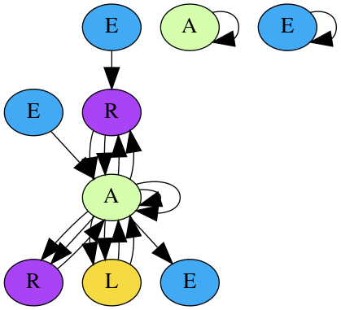







Graph-based Anomaly Detection
Often, underlying data is unmistakably relational:
physician-patient-provider
employee-employer
…
…
…
…
…
…
…
user-business reviews
account transactions
7
Notes:
In many anomaly detection application/real-world scenarios, the underlying data is UNAVOIDABLY relational - GRAPH : NATURAL
(opportunistic and/or organized)
EXAMPLES: among the ones I worked on and will talk about:
opinion fraud: review - organized
accounting anomalies: transactions
tax fraud: company-employee
among others:
medicare physician-hospital - organized and opportunistic

Slide 8
Graph-based Anomaly Detection
Several surveys and tutorials:
[Survey] Graph-based Anomaly Detection and Description: A Survey. [Akoglu+] Data Mining and Knowledge Discovery (DAMI), May 2015.
[Tutorial] Fraud Detection through Graph-Based User Behavior Modeling. [Beutel+] ACM CCS 2015.
[Tutorial] Social Media Anomaly Detection: Challenges and Solutions. [Liu & Chawla] ACM SIGKDD 2015.
[Survey] False Information on Web and Social Media: A Survey. [Kumar & Shah] arXiv:1804.08559
8
Notes:
Maybe blend this slide with the previous one:
MANY TUTORIALS on the subject (survey and tutorial/slides) - clickable links
Chawla & Yan Liu
Alex Beutel
Me

Slide 9
Challenges
Problem: Given <Data>, Find <Anomalies> s.t. <Constraints>
<Data> : Graph heterogeneity (node/edge labels, attributes, multi- edges, edge weights, edge timestamps, etc.) How or whether to “fold” meta-data into a graph
<Anomalies> : Definition/Formalization of anomalies (e.g., group anomalies vs. anomalous groups) Heterogeneity exacerbates the issue
<Constraints> : System/Application requirements e.g., distributed/ streaming/massive data, attribution (who), explainability (why)
9
Notes:
IS IT A HARD PROBLEM?
Challenges:
(1) Graph representation (e.g., Network heterogeneity),
not all graphs are the same - node labels, node attributes, multi-edges, and edge weights (accounting)
how or whether or not to “fold” meta-data into the graph (e.g., user/restaurant characteristics, journal entry meta-data)
(2) Definition of anomaly (e.g., group anomalies - and anomalous groups), and
(1) above exacerbates the situation
(3) System-wise requirements (e.g., online/streaming and explainability:e.g. attribution).
System Requirements - attribution , explainability
Adversarial, may want bounds (spectrum of resources-impact)

Slide 10
Outline
Anomaly Detection: Motivation, Formalism, Challenges
Graph-based Anomaly Detection
General-purpose (single graph) Global – anomalous nodes Local – group anomalies Collective – anomalous groups
Specialized (graph database)
Recent Trend: Deep Anomaly Detection
10
Notes:
Draw analogies: global, local, collective

Slide 11
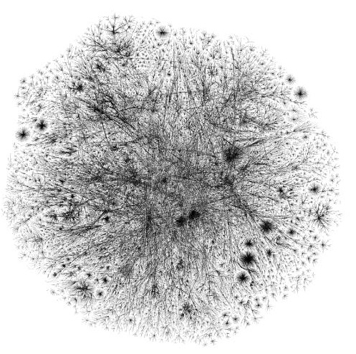
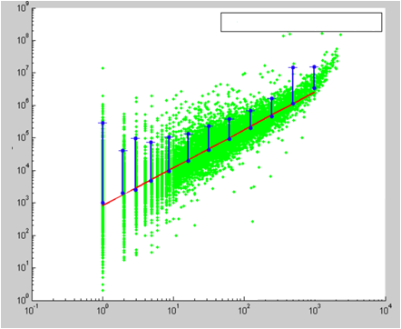
Anomalous nodes (global)
Problem Sketch:
plain, weighted, directed
11
Notes:
Clickable citation

Slide 12
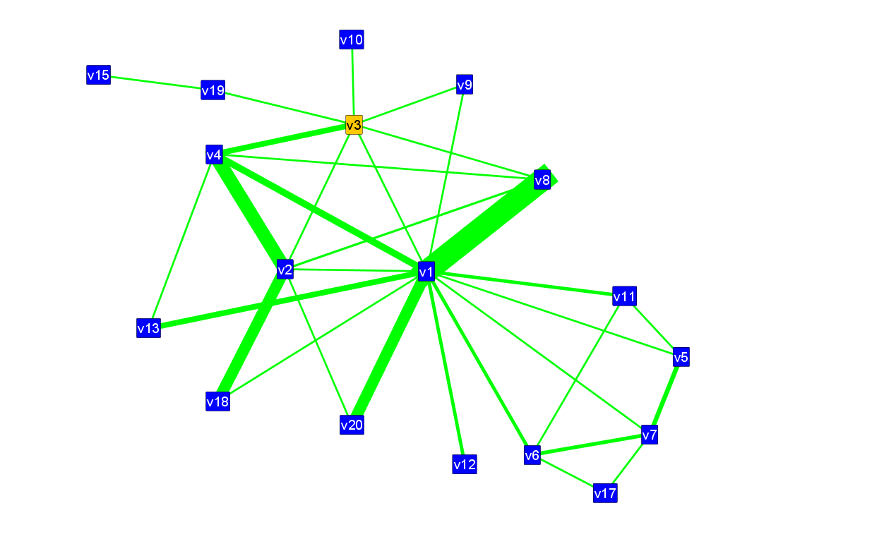
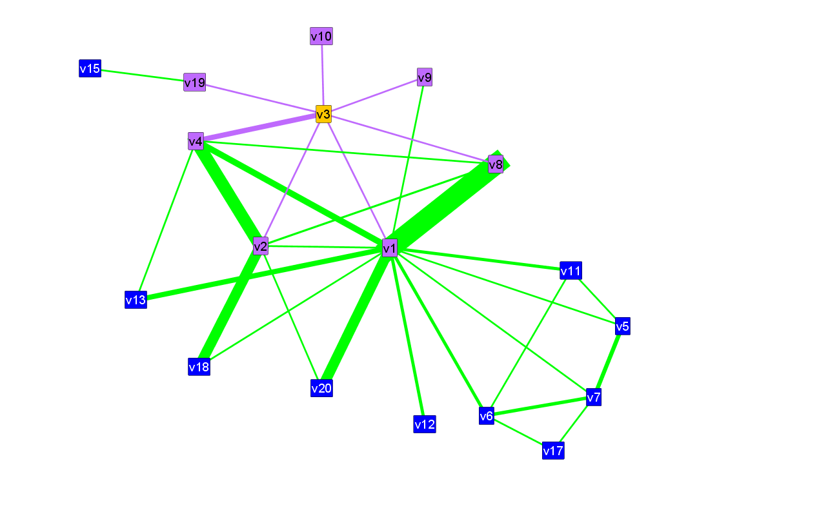
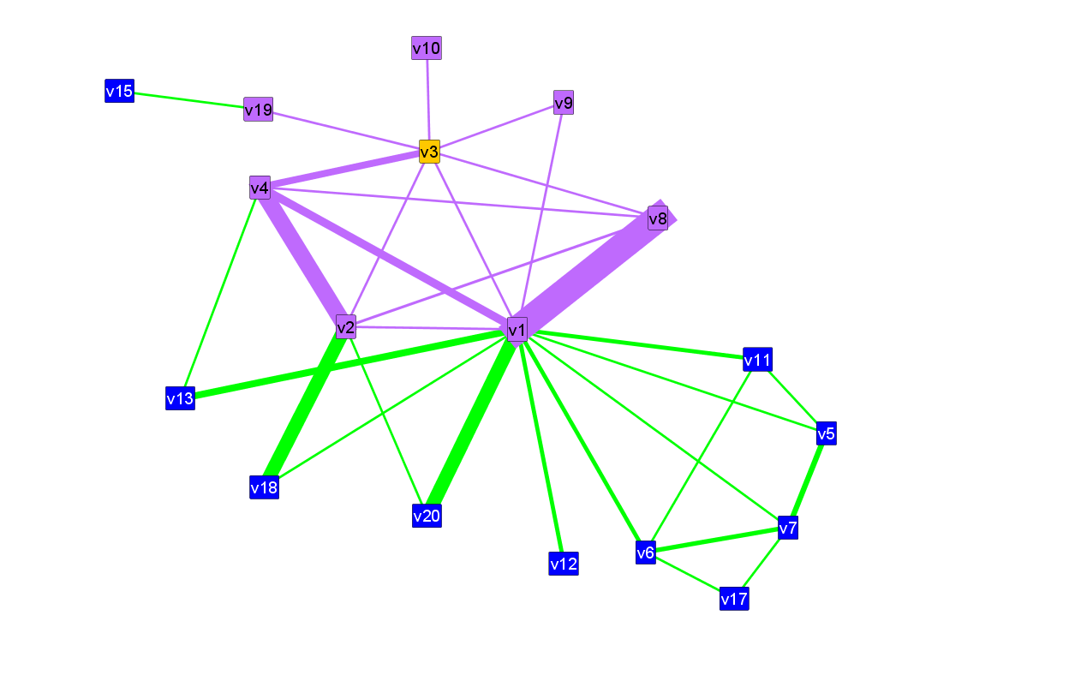
Anomalous nodes (global): OddBall
ego
For each node
Extract ego-net (1-hop neighborhood)
Extract ego-net features
Find patterns (“laws”)
Detect outliers (distance to patterns)
Problem Setting:
ego-net
OddBall: Spotting Anomalies in Weighted Graphs. [Akoglu+] PAKDD 2010.
12

Slide 13
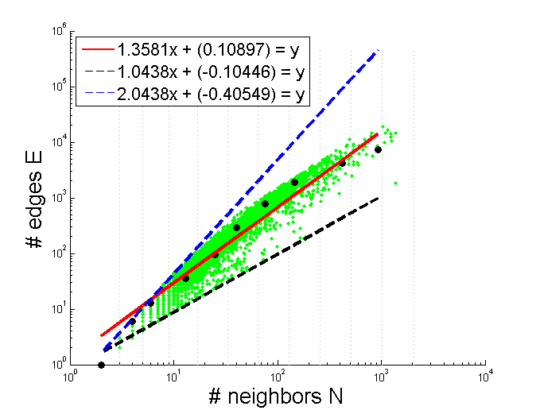
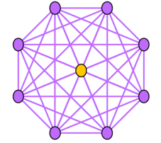
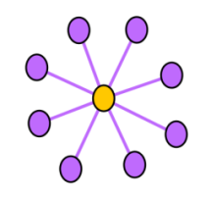
Anomalous nodes (global): OddBall
discussion group,
“rank boosting”, etc.
slope=2
slope=1.35
#edges E
slope=1
telemarketer, spammer,
port scanner, “popularity
contests”, etc.
#neighbors N
13

Slide 14
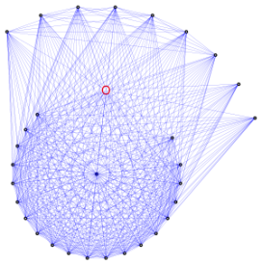
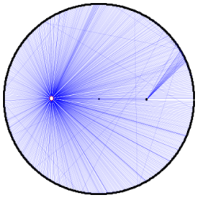
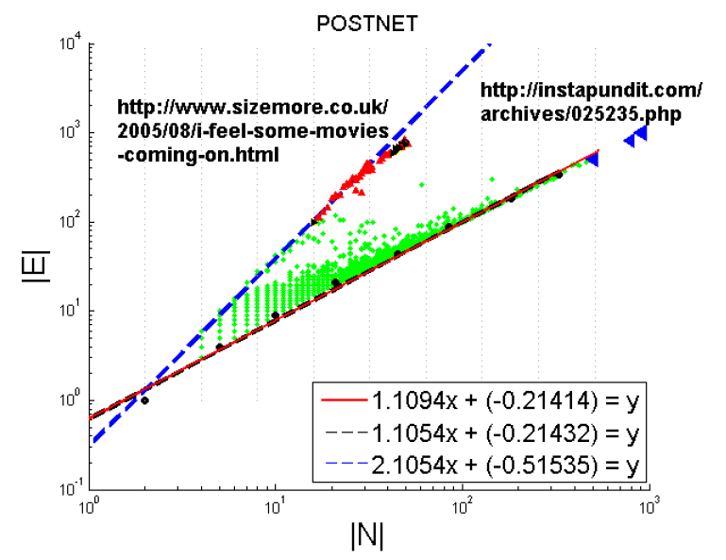
Anomalous nodes (global): OddBall
FORUM POSTS
#cross-citations
#citations
14

Slide 15


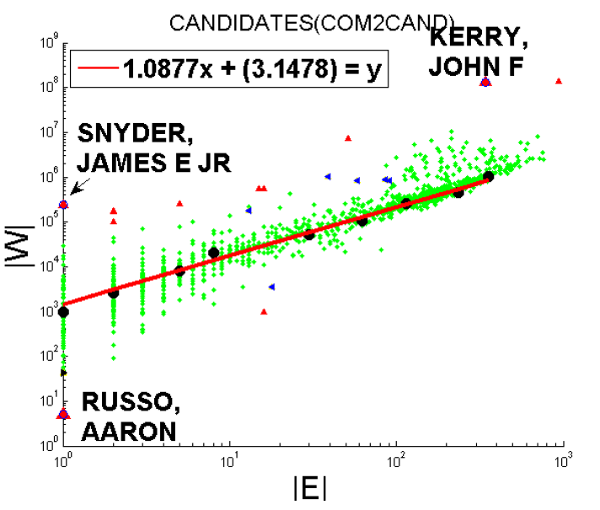
Anomalous nodes (global): OddBall
CAMPAIGN-DONATIONS
Kerry,
John F.
Snyder, James E. Jr
$
Russo, Aaron
#checks
15

Slide 16
Outline
Anomaly Detection: Motivation, Formalism, Challenges
Graph-based Anomaly Detection
General-purpose (single graph) Global – anomalous nodes Local – group anomalies Collective – anomalous groups
Specialized (graph database)
Recent Trend: Deep Anomaly Detection
16
Notes:
Draw analogies: global, local, collective

Slide 17
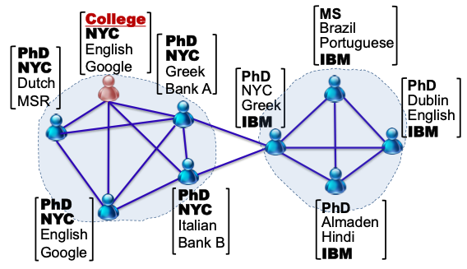
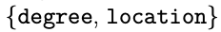
Group anomalies (local)
Problem Sketch:
(left) community “focuses” on (right) “focuses” on
17
Notes:
Clickable citation

Slide 18
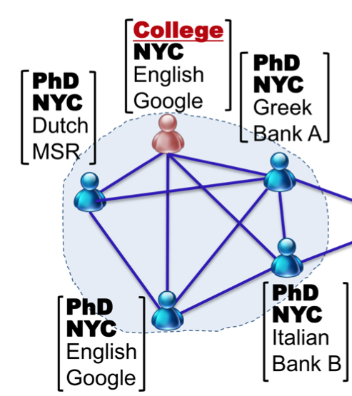
Group anomalies (local): FocusCO
Problem Setting:
Focused Clustering and Outlier Detection in Large Attributed Graphs. [Perozzi+] ACM SIGKDD, 2014.
18
Notes:
Clickable citation

Slide 19
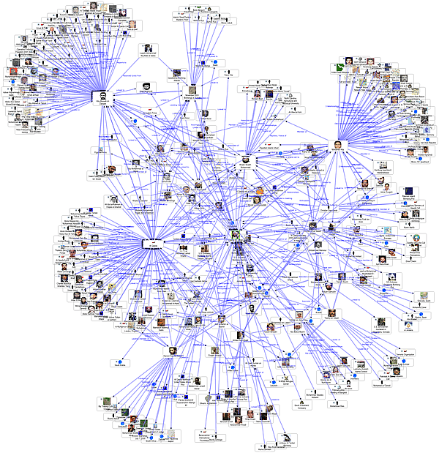

Group anomalies (local): FocusCO
1
similar pairs
cluster
extraction & (cluster) outlier
detection
dissimilar pairs
2
3
“focus”
estimation
age
gender
19
Notes:
Clickable citation

Slide 20
Group anomalies (local): FocusCO
Focus estimation
Clusters & Local outliers
attributes
nodes
S and D (intermixed)
Feature Matrix
“Focus”: feature weights
20

Slide 21
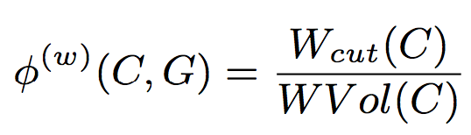
Group anomalies (local): FocusCO
Focus estimation
Clusters & Local outliers
attributes
Cluster Member
(Local) clustering obj.: conductance weighted by focus
nodes
S and D (intermixed)
Feature Matrix
Focused Outlier
node with many (but) weak ties
“Focus”: feature weights
21

Slide 22
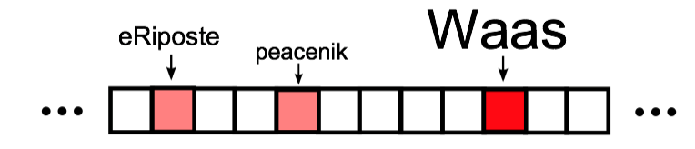
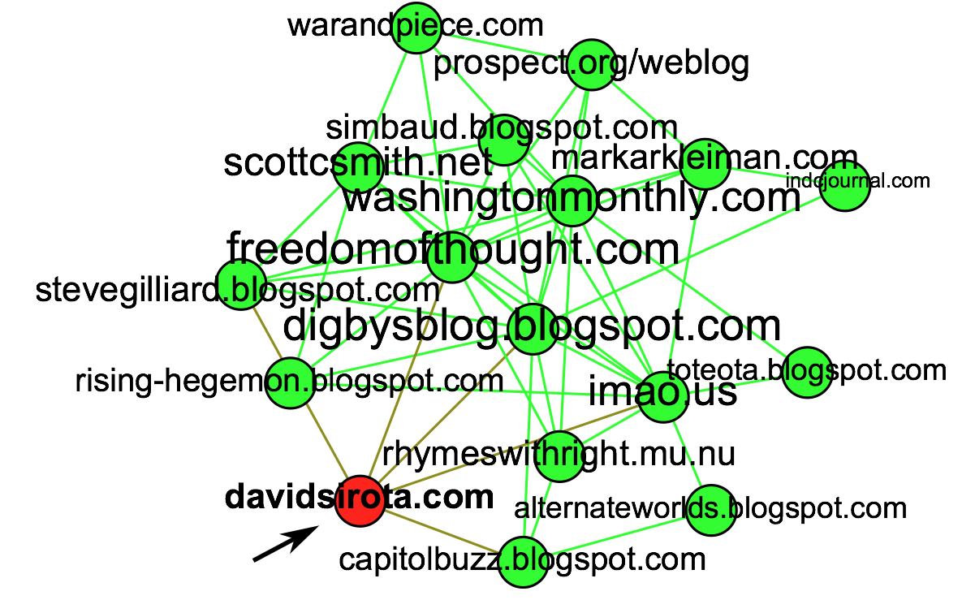
Group anomalies (local): FocusCO
Cluster Outlier did not mention Waas.
Liberal Cluster in Political Blogs Graph
22
Notes:
It contains words such as eRiposte, an active liberal blogger, peacenik, a term for an anti-war activist, and most strongly Waas. Murray Waas was an independent journalist praised for his investigative journalism of the Bush administration.8 The focused community outlier for this group is David Sirota, a well-connected liberal blogger who did not explicitly mention Waas in the dataset.

Slide 23
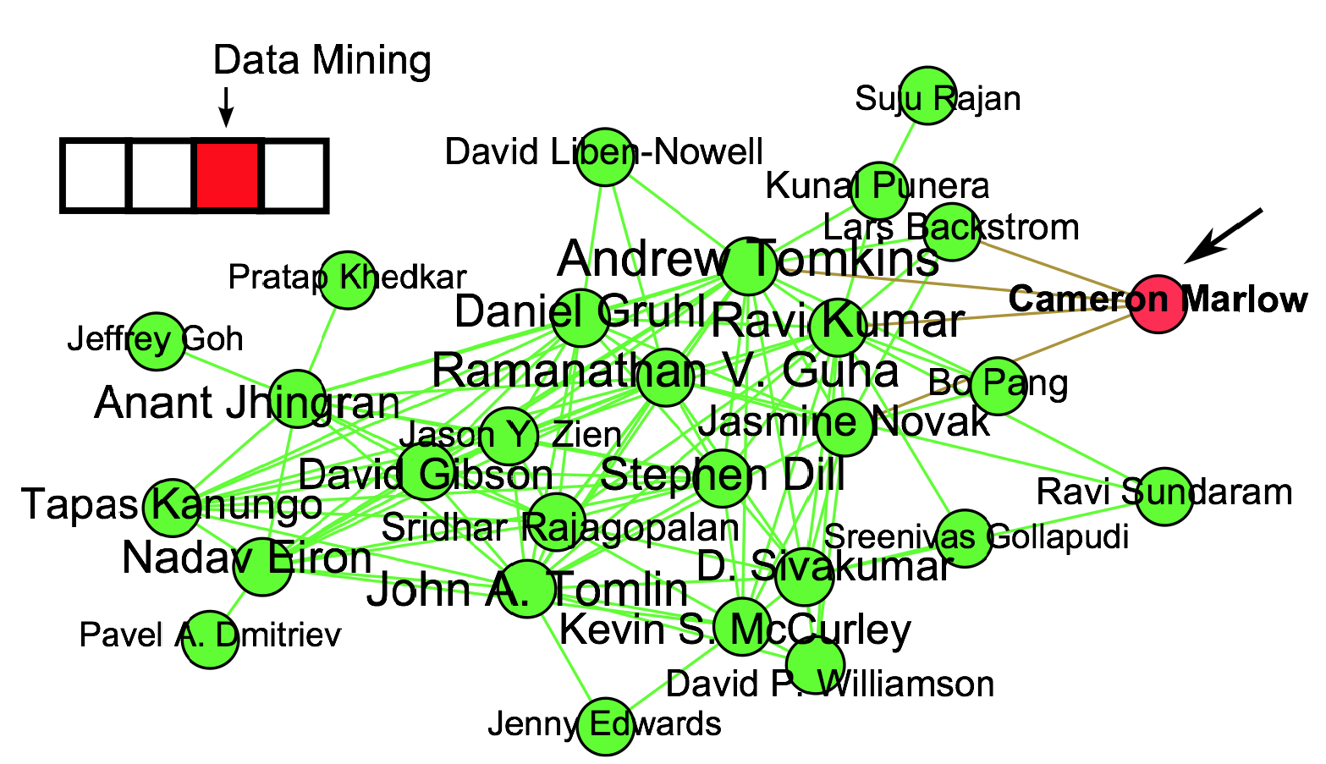
Group anomalies (local): FocusCO
Cluster Outlier publishes in IR
Focused Outlier did not mention Waas.
DBLP co-authorship graph
23
Notes:
Clickable citation

Slide 24
Outline
Anomaly Detection: Motivation, Formalism, Challenges
Graph-based Anomaly Detection
General-purpose (single graph) Global – anomalous nodes Local – group anomalies Collective – anomalous groups
Specialized (graph database)
Recent Trend: Deep Anomaly Detection
24
Notes:
Draw analogies: global, local, collective

Slide 25
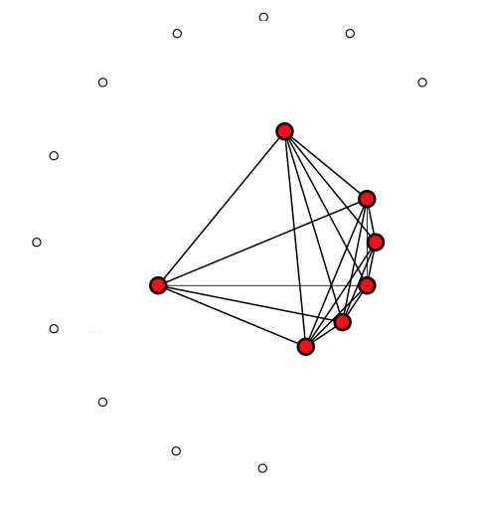
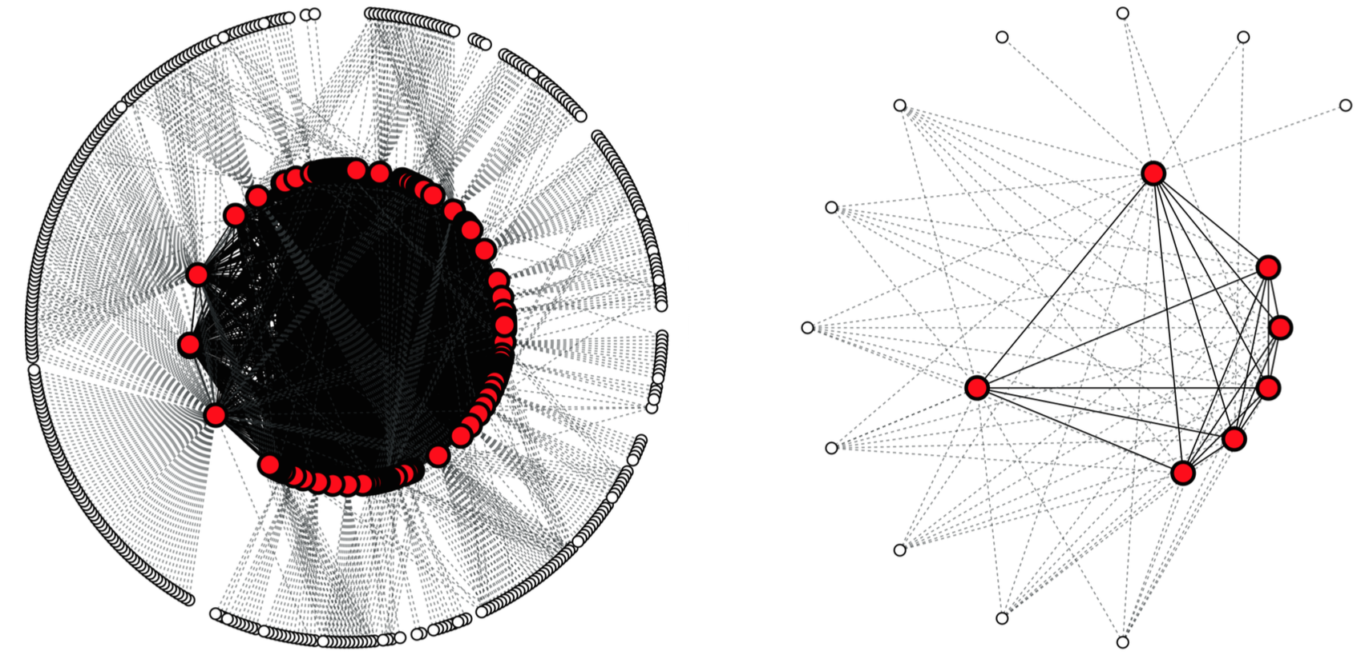
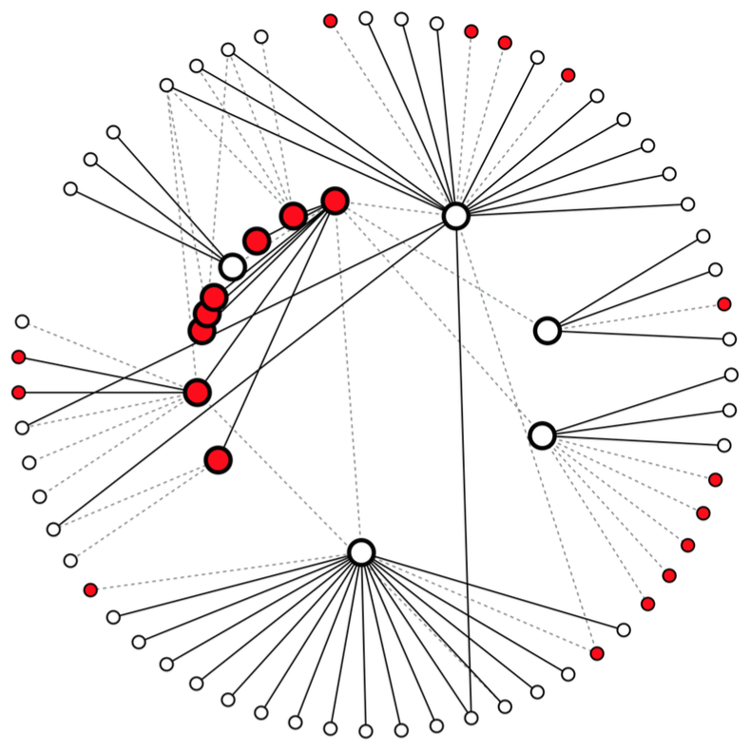
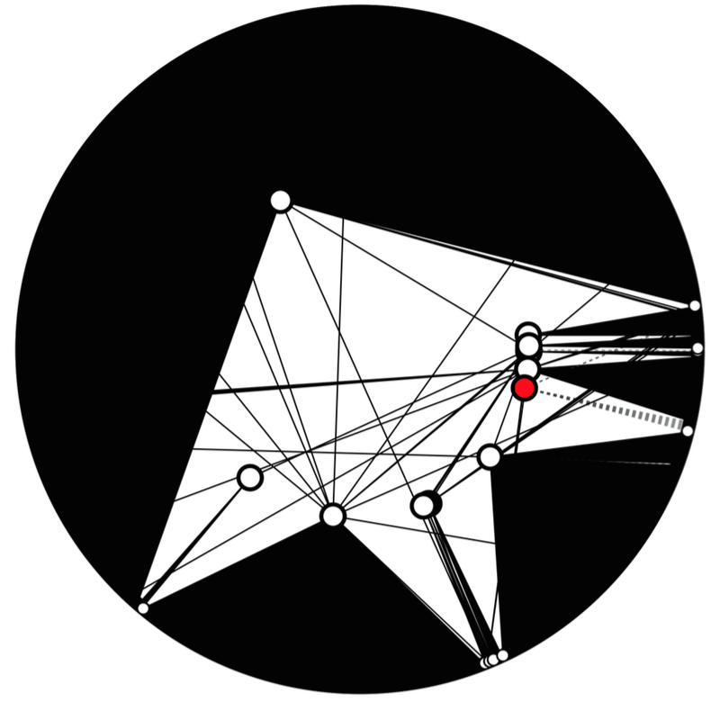
Anomalous groups (collective)
Problem Sketch: Given a node-attributed subgraph, how to define “normality”?
high
Internal
External
low
25
Notes:
Clickable citation

Slide 26
Anomalous groups (collective): AMEN
Problem Setting:
Given a subgraph in a node-attributed graph
Identify (subgraph) “focus” such that
Internal nodes are structurally dense & coherent in focus
External nodes are structurally sparse or not-surprising, or different in focus
Internal
Internal
External
Scalable Anomaly Ranking of Attributed Neighborhoods. [Perozzi & Akoglu] SIAM SDM, 2016.
26
Notes:
Clickable citation

Slide 27
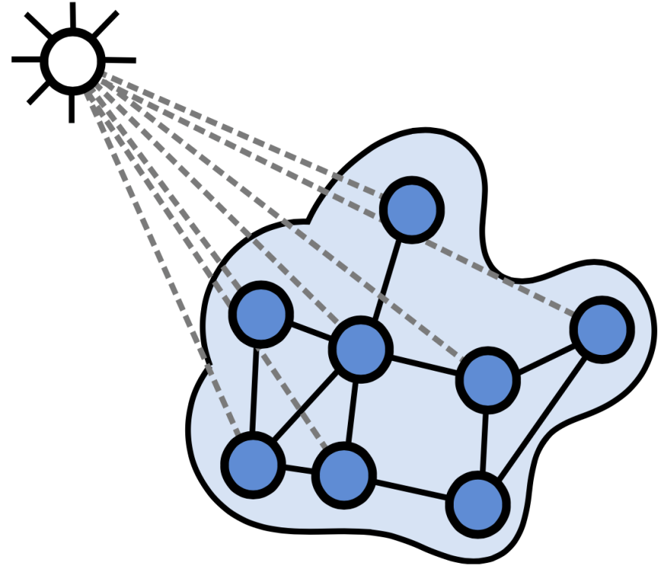
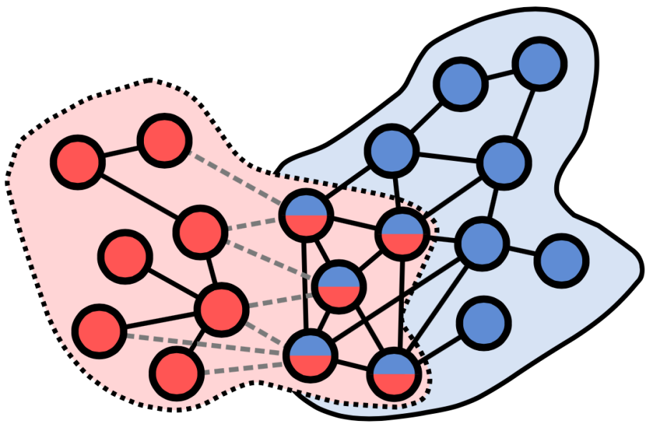
Anomalous groups (collective): AMEN
Internal nodes are structurally dense & coherent in focus
External nodes are structurally sparse or not-surprising, or different in focus
chess
biking
27

Slide 28

Anomalous groups (collective): AMEN
Measure of Normality:
null model
dot-product, or
Kronecker’s δ
internal
consistency
“focus” vector
chess
biking
28

Slide 29
Anomalous groups (collective): AMEN
Measure of Normality:
external
separability
29

Slide 30
Anomalous groups (collective): AMEN
Estimating Normality:
1
2
3
30

Slide 31
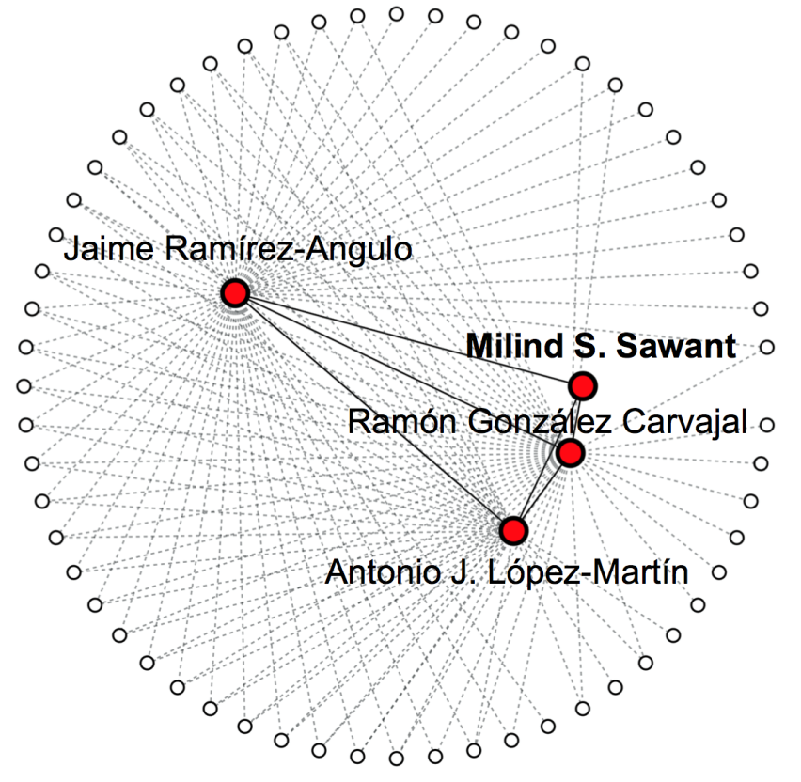
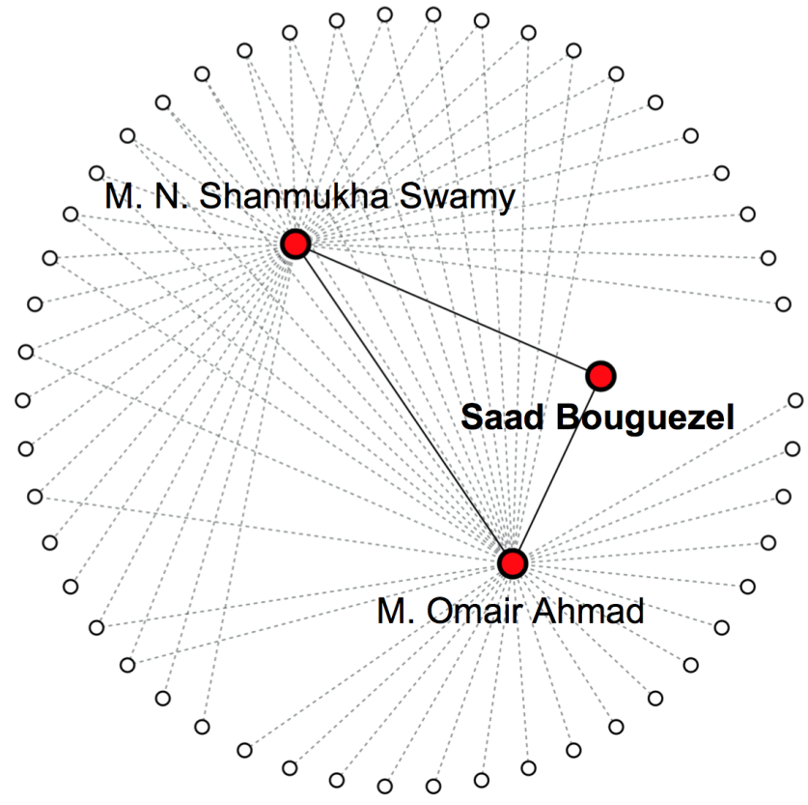
Anomalous groups (collective): AMEN
telescopic op-amps
split-radix FFT
…
…
…
…
telescopic
cascode
reciprocal
split
multidecade
reserve
31
Notes:
Clickable citation

Slide 32
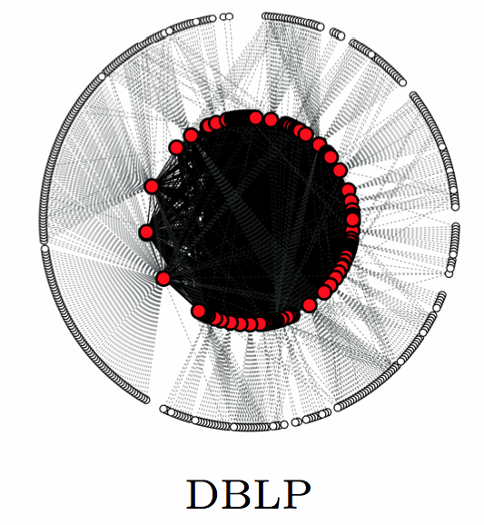
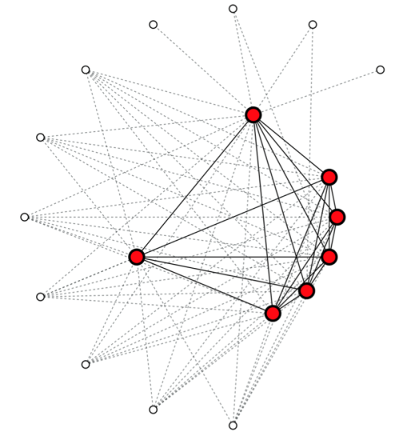
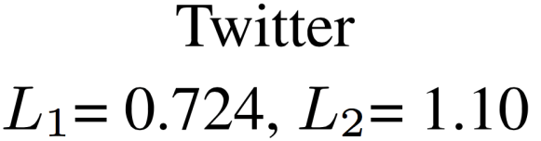
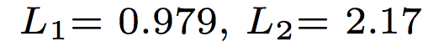
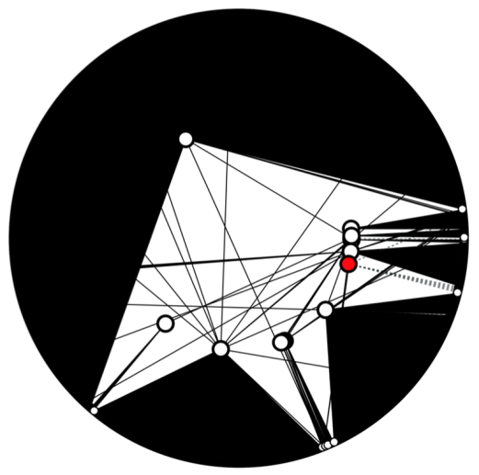
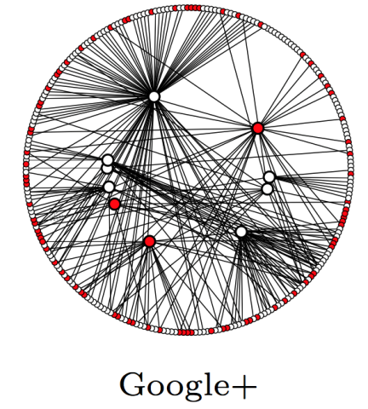
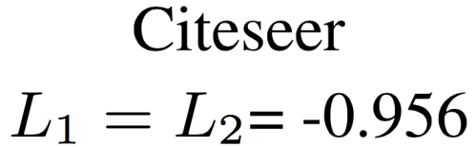
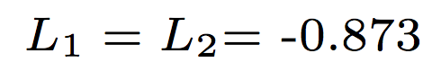
Anomalous groups (collective): AMEN
telescopic op-amps
split-radix FFT
…
…
…
…
telescopic
cascode
reciprocal
split
multidecade
reserve
32

Slide 33
Anomalous groups in malice detection
In other contexts, “too dense”ly connected groups may be indicative of malice/fraud
9/11 hijackers were densely linked via
kinship
school/training
travel/financial records
meetings
…
"Mapping networks of terrorist cells." Krebs, V. E. Connections 24.3 (2002): 43-52
33
Notes:
<<TR>>: There are other ways to define collective anomalies. We saw that in social networks context, well-behaved communities are expected to be dense. In other contexts, “too dense”ly connected groups may be indicative of fraud.

Slide 34

Anomalous groups in malice detection
Opinion fraud: Groups of users promoting/demoting businesses
…
…
Opinion Fraud Detection in Online Reviews using Network Effects. [Akoglu+] ICWSM, 2013
Collective Opinion Spam Detection: Bridging Review Networks and Metadata. [Rayana & Akoglu] ACM SIGKDD 2015
Discovering Opinion Spammer Groups by Network Footprints. [Ye & Akoglu] ECML PKDD 2015
BIRDNEST: Bayesian Inference for Ratings-Fraud Detection. [Hooi+] SIAM SDM 2016
Collective Opinion Spam Detection using Active Inference. [Rayana & Akoglu] SIAM SDM 2016
34

Slide 35
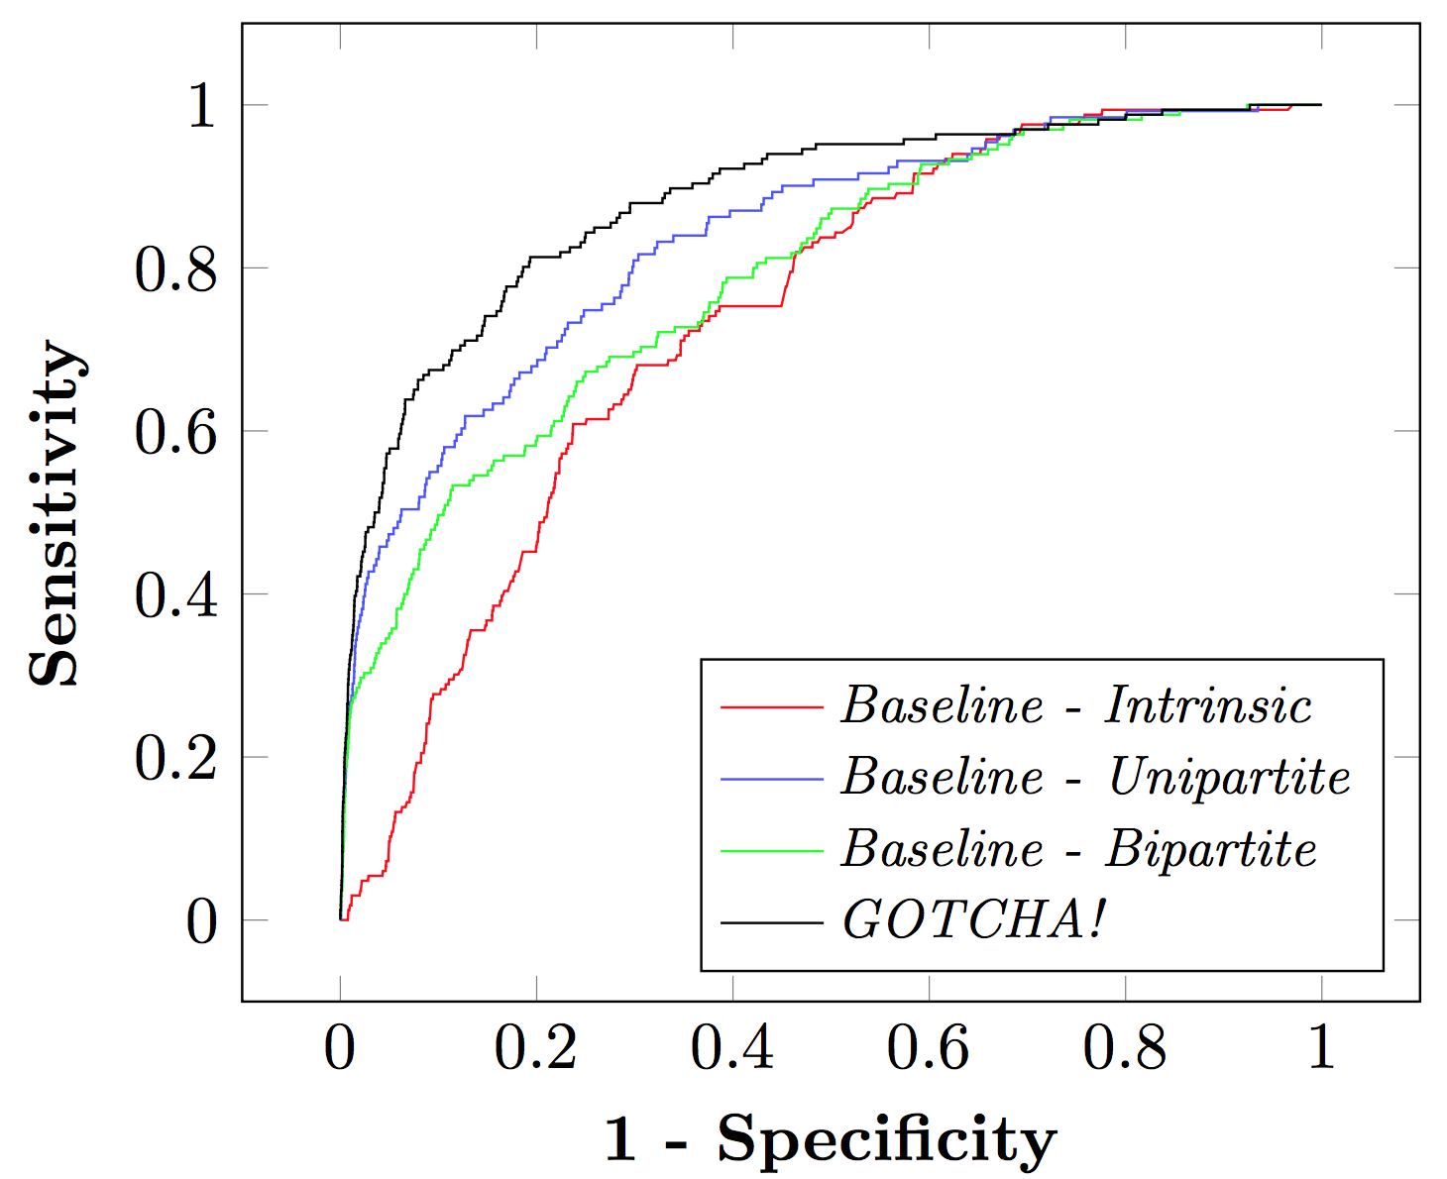
Anomalous groups in malice detection
Social securities tax fraud: Groups of resources transferred between “shadow” companies
GOTCHA! Network-based Fraud Detection for Social Security Fraud. [Van Vlasselaer+] Management Science, 63 (9), 2016
35

Slide 36
Outline
Anomaly Detection: Motivation, Formalism, Challenges
Graph-based Anomaly Detection
General-purpose (single graph) Global – anomalous nodes Local – group anomalies Collective – anomalous groups
Specialized (graph database)
Recent Trend: Deep Anomaly Detection
36
Notes:
Thus far we talked about general-purpose methods for graph anomaly detection; drawing analogies to outlier types in point-cloud data.
Next, we move closer to SPECIFIC real-world problems, where I will illustrate how those can be formalized into graph-based problems.

Slide 37
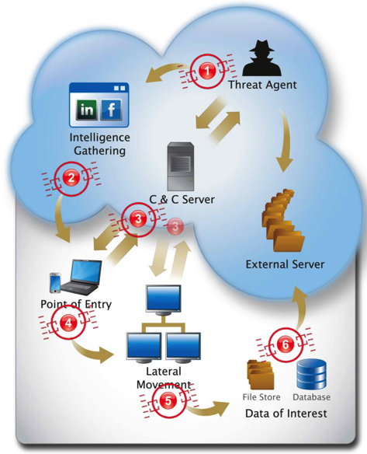
Anomalous graphs (System security)
Advanced Persistent Threat
Problem Setting :
Given a stream of event logs
Find anomalous system events
time | pid | event | arg/data
100 | 10639 | fork | NULL
200 | 10640 | execve | /bin/sh
300 | 10650 | read | STDIN
400 | 10640 | fstat | 0xbfc5598
500 | 10660 | sock_wr | 0.0.0.0
… | … | … | …
Host-level detection
37
Notes:
Clickable citation

Slide 38
Anomalous graphs (System security)
Advanced Persistent Threat
Problem Setting :
Given a stream of event logs
Find anomalous system events
Requirements :
Real-time detection
Low-latency
Low computational overhead
Low memory usage
Given <DATA>, Find <ANOMALIES> s.t. <CONSTRAINTS>
Host-level detection
Fast Memory-Efficient Anomaly Detection in Streaming Heterogeneous Graphs. [Manzoor+] ACM SIGKDD, 2016.
38
Notes:
Clickable citation

Slide 39

Anomalous graphs (System security)
Each event associated with a logical flow (tag)
Events from different flows may interleave
Each event as a directed edge :
! Many, simultaneously-growing node&edge-labeled graphs ! Universe of labels unknown
time | pid | event | arg/data | tag
100 | 10639 | fork | NULL | 1
200 | 10640 | execve | /bin/sh | 1
300 | 10650 | read | STDIN | 2
400 | 10640 | fstat | 0xbfc5598 | 1
500 | 10660 | sock_wr | 0.0.0.0 | 2
… | … | … | … | …
39
Notes:
We don’t see any graphs here yet…

Slide 40
Anomalous graphs (System security)
Graph representation z: a set of k-shingles
Distance-based graph anomalies:
 | z_{G} | z_{G’}
A | 0 | 2
C | 1 | 1
D | 1 | 0
E | 1 | 0
AxByC | 1 | 1
BrArA | 0 | 1
BpEoD | 1 | 0
B
<600,o>
D
AxByC
BpEoD
C
D
E
<100,x>
Graph G
A
<300,p>
<500,y>
C
E
B
<650,r>
A
<200,x>
AxByC
BrArA
C
A
A
! Many, simultaneously-growing node&edge-labeled graphs ! Universe of labels unknown
Over time:
! Vector entries will be updated
Graph G’
A
<300,r>
<400,y>
C
A
! Vector dimension may increase
40

Slide 41
Anomalous graphs (System security)
Graph sketching (static)
L projector vectors w/ {-1,+1}
L-bit graph sketch based on z_{G}
41

Slide 42
Anomalous graphs (System security)
Graph sketching (static)
L projector vectors
! Requires r₁, …, r_{L} in memory → |S| can be very large
! |S| unknown
Graph sketching (streaming)
L hash functions h₁, …, h_{L} :
Static :
Dynamic/Incremental :
42

Slide 43
Anomalous graphs (Accounting)
Double-entry Bookkeeping example journal entry:
Problem Setting :
Given millions of journal entries
Find anomalies (entry errors, misconduct, etc.)
GL_Account_Number | CA_FS_Caption | Cr/Db | GL_Reporting_Amount
40020000 (Revenue) | Gross Sales (GSL) | C | -7250
40020000 (Revenue) | Gross Sales (GSL) | C | -2500
20830000 (Liabilities) | Sales Tax Payables (STP) | C | -794.63
10390000 (Assets) | Accounts Receivable (ARV) | D | 10544.63
Given <DATA>, Find <ANOMALIES> s.t. <CONSTRAINTS>
43
Notes:
We don’t see any graphs here yet…

Slide 44
Anomalous graphs (Accounting)
Double-entry Bookkeeping example journal entry:
Problem Setting :
Given millions of journal entries
Find anomalies (entry errors, misconduct, etc.)
Requirements :
Explainability (audit)
GL_Account_Number | CA_FS_Caption | Cr/Db | GL_Reporting_Amount
40020000 (Revenue) | Gross Sales (GSL) | C | -7250
40020000 (Revenue) | Gross Sales (GSL) | C | -2500
20830000 (Liabilities) | Sales Tax Payables (STP) | C | -794.63
10390000 (Assets) | Accounts Receivable (ARV) | D | 10544.63
Given <DATA>, Find <ANOMALIES> s.t. <CONSTRAINTS>
Anomaly Detection in Large Labeled Multi-Graph Databases. [Nguyen+] arXiv:2010.03600, 2020.
44
Notes:
We don’t see any graphs here yet…

Slide 45
Anomalous graphs (Accounting)
Transaction graphs:
GL_Account_Number | CA_FS_Caption | Cr/Db | GL_Reporting_Amount
40060000 (Revenue) | Gross Sales (GSL) | C | -1575.00
10415000 (Assets) | Accounts Receivable (ARV) | D | 1575.00
Gross Sales
$ 1575
Accounts Receivable
GL_Account_Number | CA_FS_Caption | Cr/Db | GL_Reporting_Amount
40020000 (Revenue) | Gross Sales (GSL) | C | -7250
40020000 (Revenue) | Gross Sales (GSL) | C | -2500
20830000 (Liabilities) | Sales Tax Payables (STP) | C | -794.63
10390000 (Assets) | Accounts Receivable (ARV) | D | 10544.63
Gross Sales
$ 7250
Accounts Receivable
Gross Sales
Sales Tax Payables
$ 2500
$ 794.63
45
Notes:
Clickable citation

Slide 46
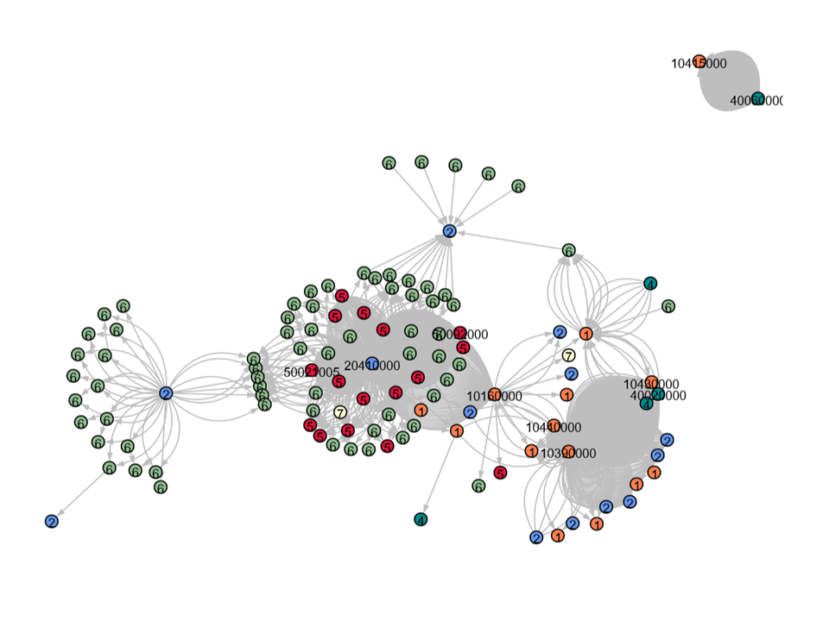
Anomalous graphs (Accounting)
Transaction graph of journals over 10-day window:

Slide 47
Anomalous graphs (Accounting)
Anomaly detection via data description/encoding
Graph cover
47
Notes:
Ties with deep learning

Slide 48
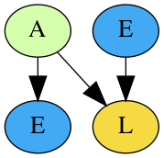
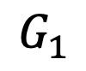
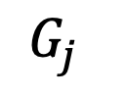
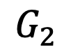
Anomalous graphs (Accounting)
Anomaly detection via data description/encoding
$$G_{1}$$
5 g₁
2 g₃
1 g₄₅
$$G_{2}$$
1 g₃
4 g₂₀₀
…
g₂₀₀
$$G_{j}$$
1 g₂
48
Notes:
Ties with deep learning

Slide 49
Anomalous graphs (Accounting)
Anomaly detection via data description/encoding
Path injections
Type perturbations
49
Notes:
Ties with deep learning

Slide 50
Outline
Anomaly Detection: Motivation, Formalism, Challenges
Graph-based Anomaly Detection
General-purpose (single graph) Global – anomalous nodes Local – group anomaly Collective – anomalous groups
Graph-level anomalies
Recent Trend: Deep Anomaly Detection
50

Slide 51
Deep Anomaly Detection
Representation learning: transformative for applications in NLP/translation, recommender systems, etc.
Why not automatically learn data representations for anomaly detection?
Ideas easily transfer to graph data
Deep Learning for Anomaly Detection: A Survey. [Chalapathy & Chawla] Jan. 2019
Deep Learning for Anomaly Detection: A Review. [Pang+] July 2020
A Unifying Review of Deep and Shallow Anomaly Detection. [Ruff+] Sep. 2020
51
Notes:
Clickable citation

Slide 52
Deep Anomaly Detection
Graph Embedding
Outlier Detector
52

Slide 53
Deep Anomaly Detection
Graph Embedding
Unsupervised model selection – likely a critical future direction
Embeddings capture general prevalent patterns, may not be suitable for anomaly detection
Hyper-parameter tuning becomes key for success!
Can seamlessly handle various types of graphs: labeled, attributed, multi-edges, weights
Can do end-to-end learning (one-class, reconstruction)
53

Slide 54




Graph-based Anomaly Detection
Code, Data, Papers, Slides
www.cs.cmu.edu/~lakoglu/
Thanks!

